Slide 1
AIT 690 – Data Analytics in Social Media - Final project presentation
Analyzing influencers and geographical sentiment distribution for tweets on the Zika Virus in the United States
GVS Akshay (Team Leader)
Saurabh Rao
Kaushik Kandlakunta

Slide 2
Motivation
To understand :
Conversation about the Zika Virus in regions with the highest population in the United States.
Sentiment distribution in each region
Major keywords regarding the Zika virus
Major influencers

Slide 3
Hypothesis
-Most conversations about Zika in the United States are influenced by individuals.
-Regions close to the coast which are more likely to receive people harboring the Zika virus are more concerned about virus.
-The overall sentiment is neutral, owing to the informational nature of the tweets.

Slide 4
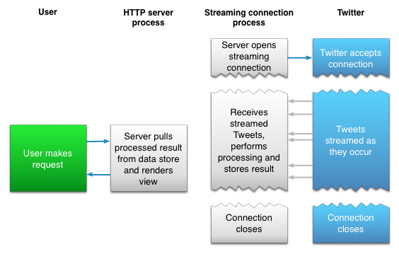
Data collection
Gather API credentials from Twitter developers (access tokens)
Download twitteR package for R
Authenticate application and create cred environment
Define required variables
Define latitude, longitude and radius variables
Define sentiment function
Make REST API call
Avoid rate limiting

Slide 5
Data Description
Created – time and date variable
favoriteCount – integer
favorited id – long integer
isRetweet – Boolean (T/F)
Latitude -long integer
Longitude – long integer
replyToSID – string
replyToSN – string
replyToUID – string
retweetCount – integer
Retweeted – Boolean (T/F)
screenname – string
statusSource – string
Text – string
truncated - Boolean(T/F)

Slide 6
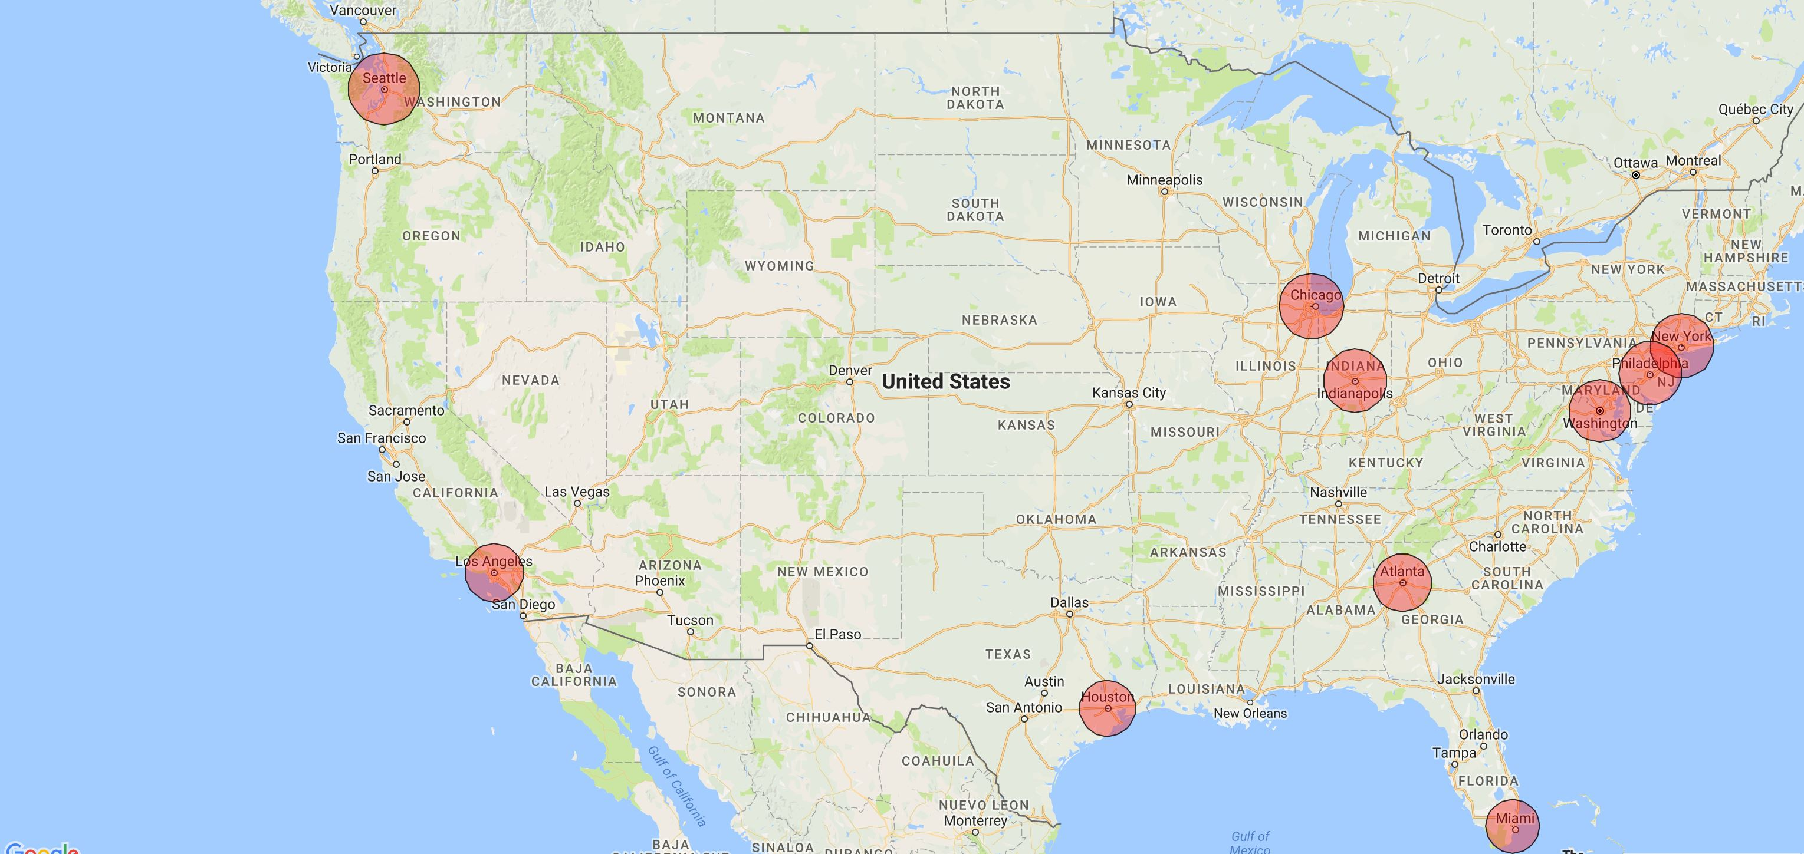
Geographic distribution of tweet collection

Slide 7
Data cleaning
- Convert text from UTF-8 to ASCII
Remove punctuation marks
Remove “@”
Convert to lowercase
Tokenize for further use in tf-idf calculation

Slide 8
Sentiment analysis
Collect a corpus of negative and positive keywords ( ~ 7000 words )
Convert each tweet as a string and save entire dataset as a dataframe
For each tweet , calculate score as follows : If positive keyword encountered , score_pos= + 1 If negative keyword encountered , score_neg= -1
Total score = score_pos + score_neg
Assign label as positive, negative or neutral based on score
Repeat process for each geographical region under consideration

Slide 9
Getting node edge list part 1 – reasoning and types
A tweet can be retweeted from someone, can be a reply to another tweet.
This has a cascading effect (a retweeted tweet can be retweeted again)
Instead of a cascading structure, we used a time constraint based approach.
This is to understand the “virality” of the tweet (retweet count in a predefined time delta)
For retweet , extract username of person retweeted from and person retweeting ( source and target node )
For reply , extract original tweet and reply tweet ( source and target node )

Slide 10
Getting node edge list part 2 – assigning weights
Considered retweet count , favorite count , Reply or not for weight.
Normalize retweet count, favorite count by dividing every entry by maximum value in each column ( ie, maximum possible value is 1 ).
Reply or not is a Boolean value , convert to 1 for TRUE , 0 for FALSE.
Assign weights by using the formula weight= X1*(Normalized_rt_count) + X2*(Normalized_fav_count) + X3*(Reply_or_not)
∋ for tweet_count=(1:n)
{ Σ(Normalized_rt_count[tweet_count] + Normalized_fav_count[tweet_count] + Reply_or_not[tweet_count]) = Σ weight }
Where X1,X2,X3 are constant values ∋ 0 ≤ X1,X2,X3 ≤ 1 .
X1,X2,X3 are heuristically tweaked to ensure the optimal degree of normality. Condition for normality : mean(Σweight) ≈ median(Σweight) ≈ mode.mult(Σweight)

Slide 11
Exploratory data analysis
Total population : 61125196 (18.92% of total US population)
Total tweets : 3095

Slide 12
Wordcloud
# To be done by Akshay

Slide 13
Closeness centrality etc values for replies , retweet , combined …put it into a table .
#to be done by akshay
( add more slides here if needed )

Slide 14
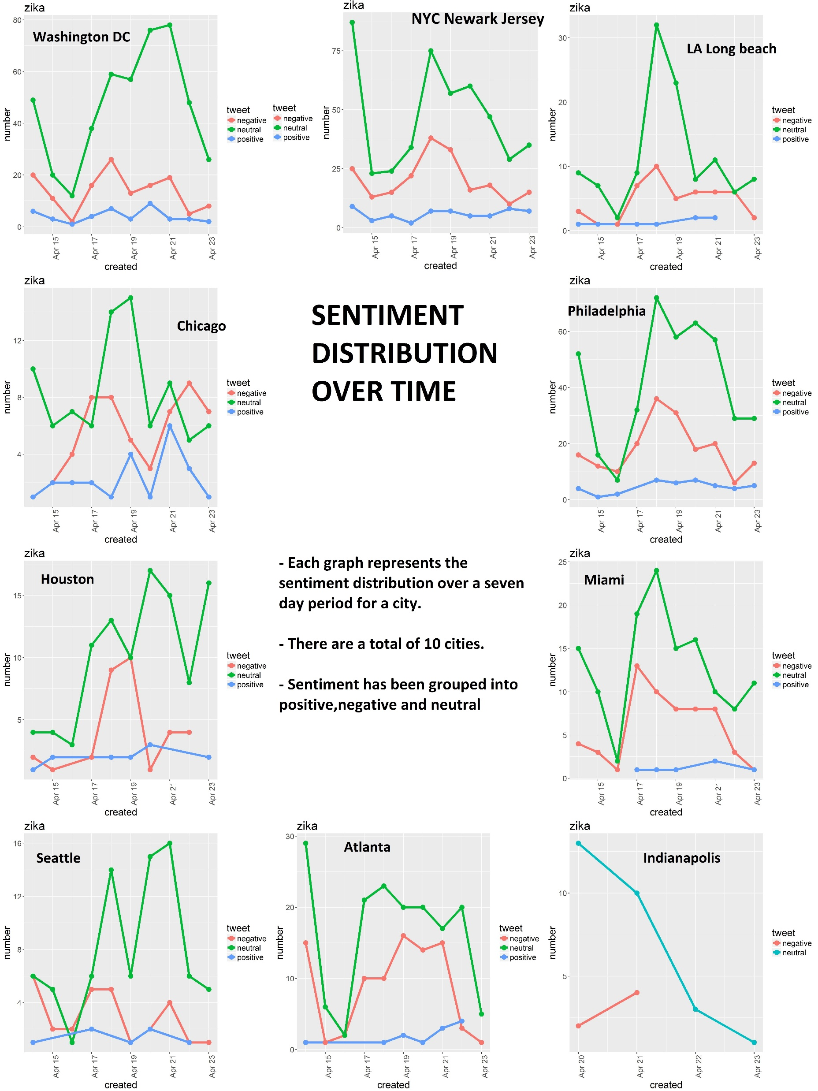
Sentiment

Slide 15
TF IDF
# to be done by akshay

Slide 16
Hypothesis
-Most conversations about Zika in the United States are influenced by individuals.
-Regions close to the coast which are more likely to receive people harboring the Zika virus are more concerned about virus.
-The overall sentiment is neutral, owing to the informational nature of the tweets.
Conclusions
-Most conversations about Zika in the United States are influenced by corporations and issue specific accounts rather than individuals.
-Regions close to the East coast are more concerned about the Zika virus than those in the Midwest , center or West coast.
-The overall sentiment is neutral, owing to the informational nature of the tweets.

